Slide 1
Form Understanding using supervised fine tuning machine learning algorithm on a pretrained large language and vision model
Arpit Agrawal
Thesis Presentation
April 2024

Slide 2
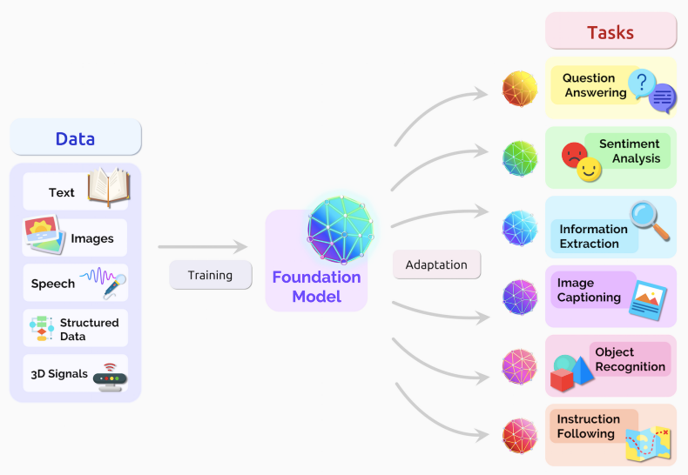
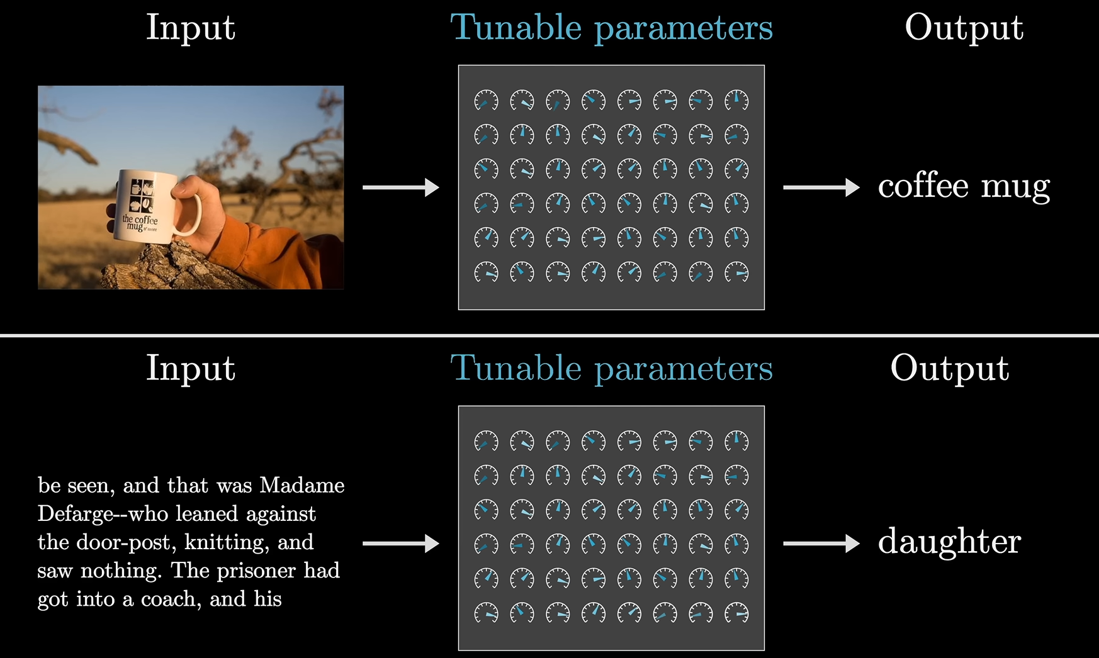
Pre-trained Large Language Model (LLM)
Large dataset(100s GBs or TBs)
Unsupervised Training
Model Learns Context
With language input it learns grammar rules, linguistic patterns, factual information, and reasoning abilities
However without adaptation, accuracy of the model on a certain task is quite low

Slide 3
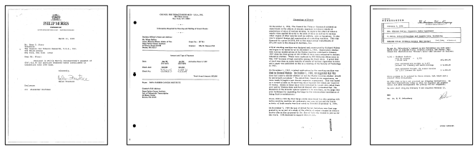
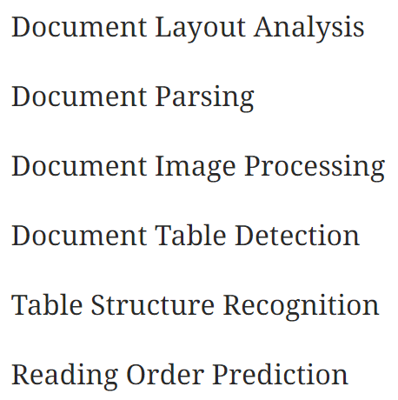
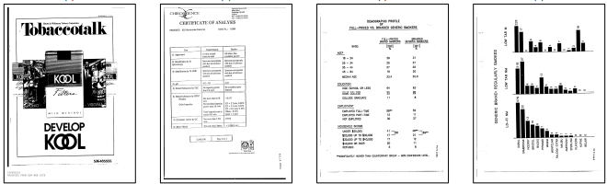
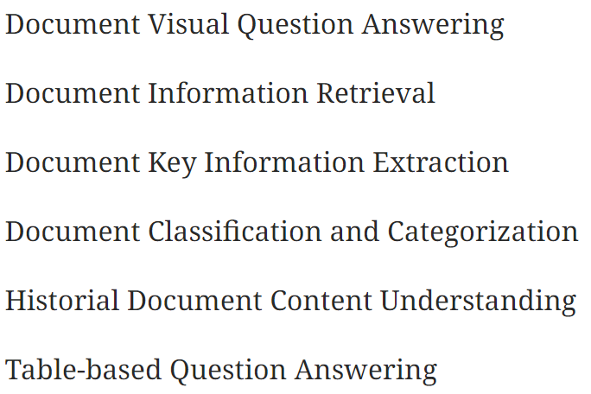
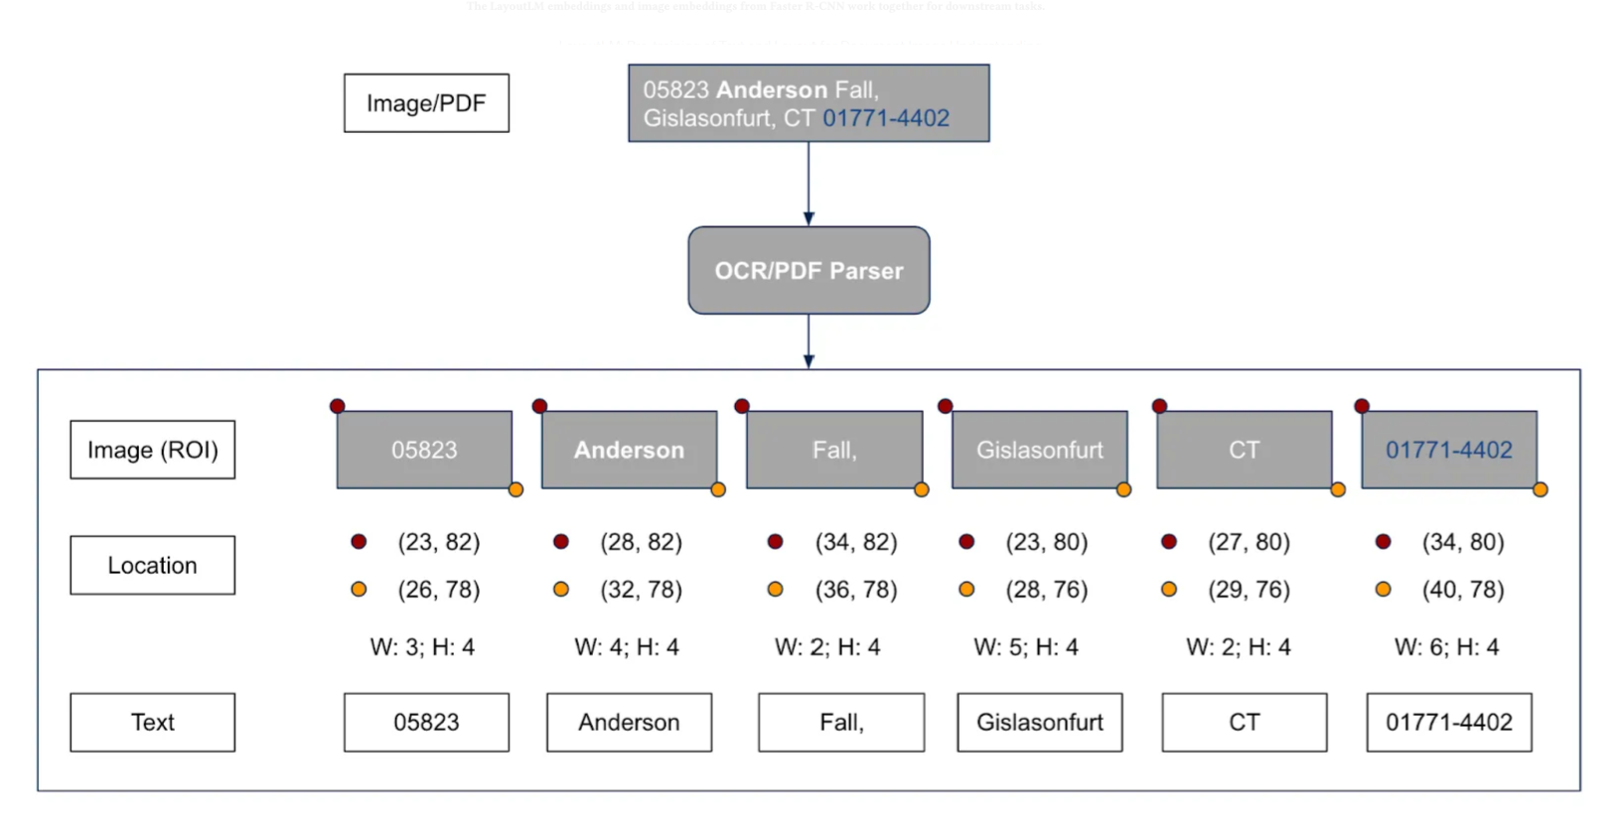
Pre-trained LLM for Document Understanding
OCR Text
OCR Text + Bounding Box
OCR Text + Bounding Box + Image Feature map(CNN)
OCR Text + Bounding Box + Image(ViT)

Slide 4
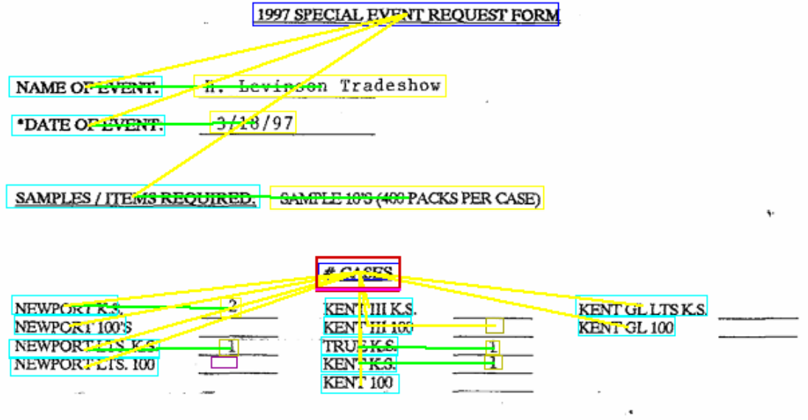
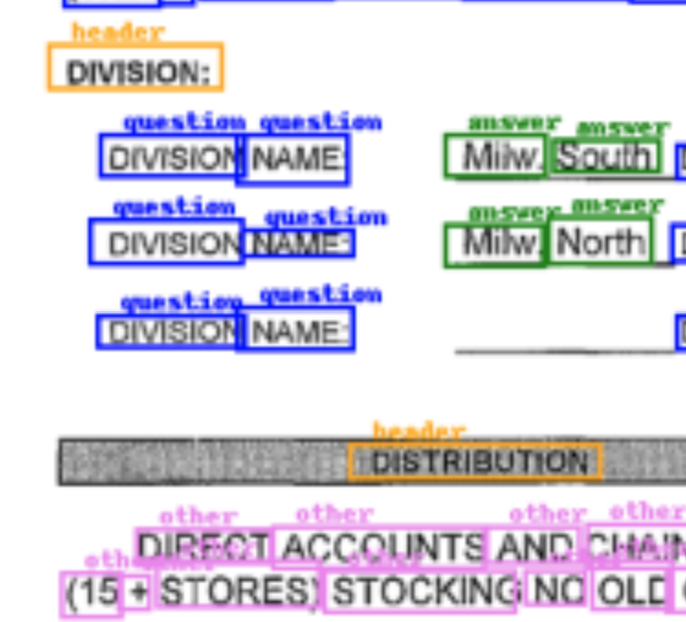
Fine-tuning Pre-trained LLM for Form Understanding
Word grouping
Semantic Entity Labelling
Semantic Entity Linking
Fine-tuning
Full fine-tuning approaches
Parameter-efficient fine-tuning methods (PEFT)
Prompt engineering strategies
Multi-task learning
Adapter-based fine-tuning
Meta-Adapters: Parameter Efficient Few-shot Fine-tuning
Sandboxed tuning environments

Slide 5
Aim and Objectives
The primary aim of this research is to implement a fine-tuning technique for a pre-trained model to achieve state-of-the-art performance in form information extraction task
The research objectives are defined in line with the purpose of this study and are listed below:
• To fine-tune a pretrained large language model targeting form information extraction
• To evaluate the fine-tuned model performance on benchmark dataset

Slide 6
Challenge : How best to incorporate spatial and layout information
pre-processing layout information
using CNNs to develop feature maps of the high-level spatial information
adding it at different levels (early fusion or late fusion) in the transformer architecture (LayoutLM vs LMv2)
using different pre-training objectives to learn the spatial context
formulate correct reading order before feeding the positional information to the model

Slide 7
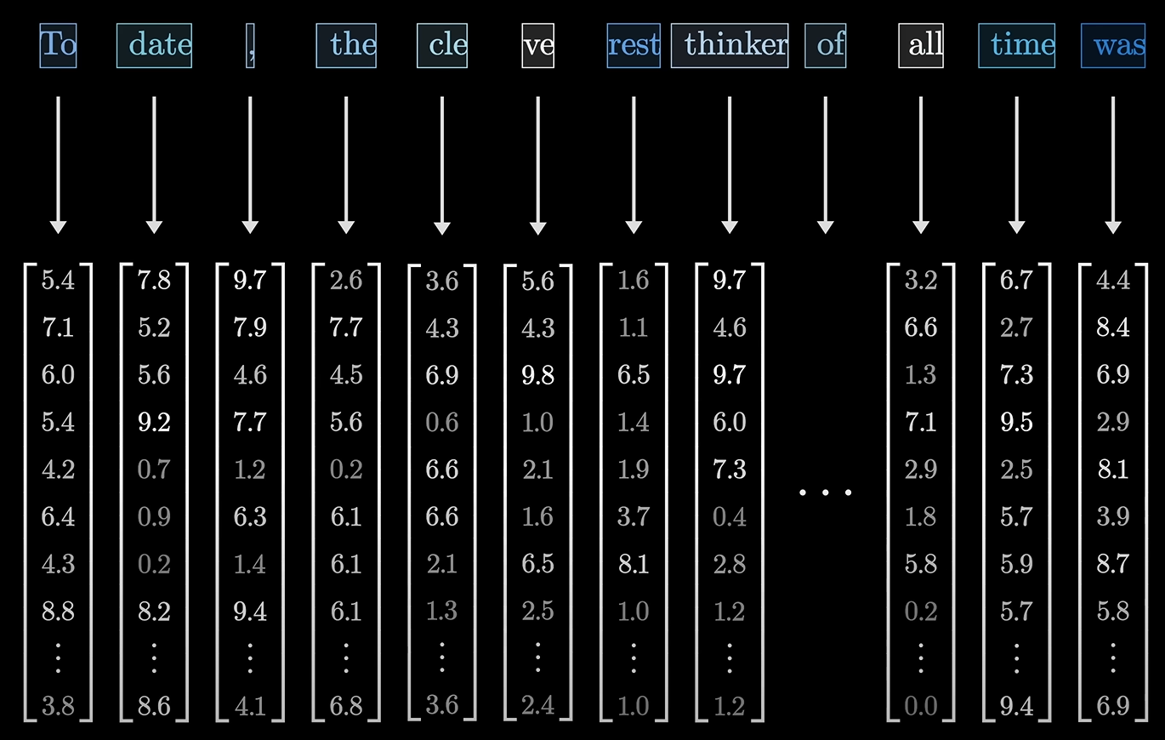
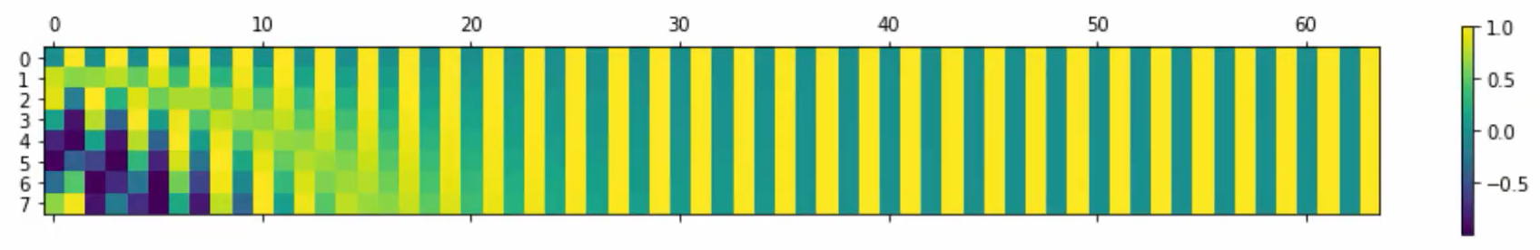
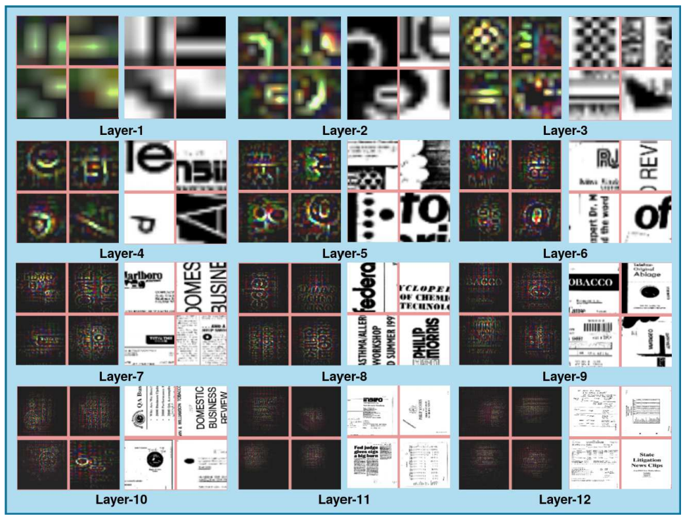
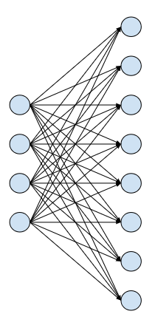
Text | Layout | Image
Sinusoidal encodings
Text -> Tokens -> Vectors
Each Model has its own Vocabulary
Its own tokenization encoding
Its own token ids
The initial layers of a CNN network learn more generic features while higher layers learn class specific features
Generic features : horizontal edges, vertical edges, diagonal edges, circular edges, corresponding to circular parts of English characters. Intermediate Layers learns small structure presents in document type such as characters (like ‘e’, ‘5’, ‘p’ and ‘A’) and small circular structures. Final Layer learns features corresponding to text present in a complete document.
Using a linear projection layer to map bounding box coordinates to model dimension

Slide 8
Literature Review
MODEL | MODEL TYPE | DATA MODALITIES | FEATURES
LAMBERT | Encoder | Text, Layout | Language modeling, attention mechanisms, document layout focus
BERTGrid | Encoder | Text, Layout | BERT extension for grid-like structures, form and table processing
LayoutLM | Encoder | Text, Layout, Visual | Text, layout, visual integration for document understanding(late fusion)
LayoutLMv2 | Encoder | Text, Layout, Visual | Enhanced LayoutLM(early fusion), refined multimodal document processing capabilities
TILT | Encoder-Decoder | Text, Layout, Visual | Transformer encode-decode, layout and visual information handling for translation or summarization
BROS | Encoder | Text, Layout | Sentence representation with layout awareness
LayoutT5, LayoutBART | Encoder-Decoder | Text, Layout, Visual | Adaptation of T5 and BART for document understanding with text, layout, and visual features
DocFormer | Encoder | Text, Layout, Visual | Transformer-based, processes text, layout, and visual elements for document interpretation

Slide 9
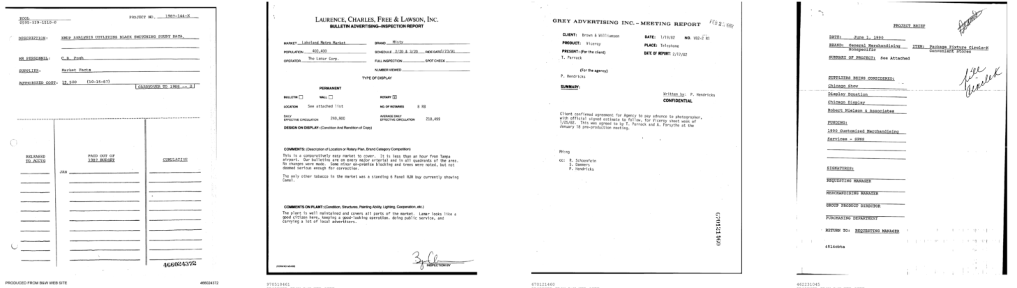
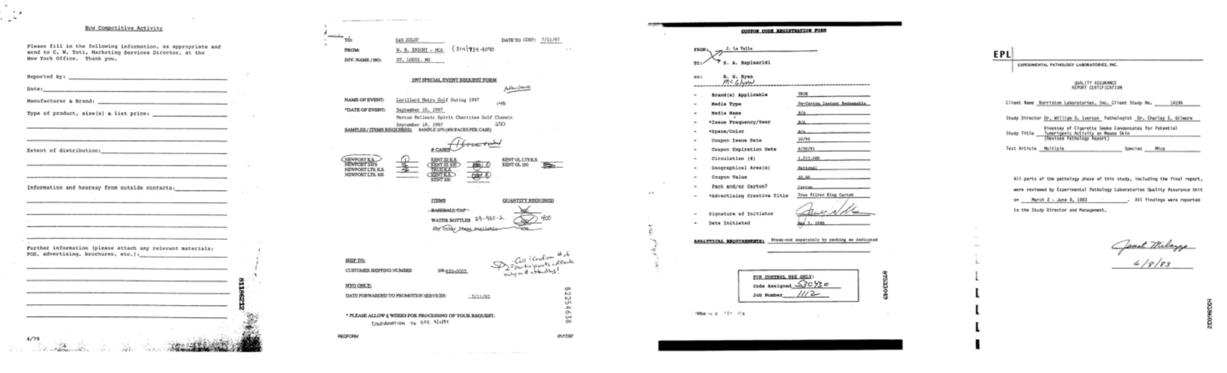
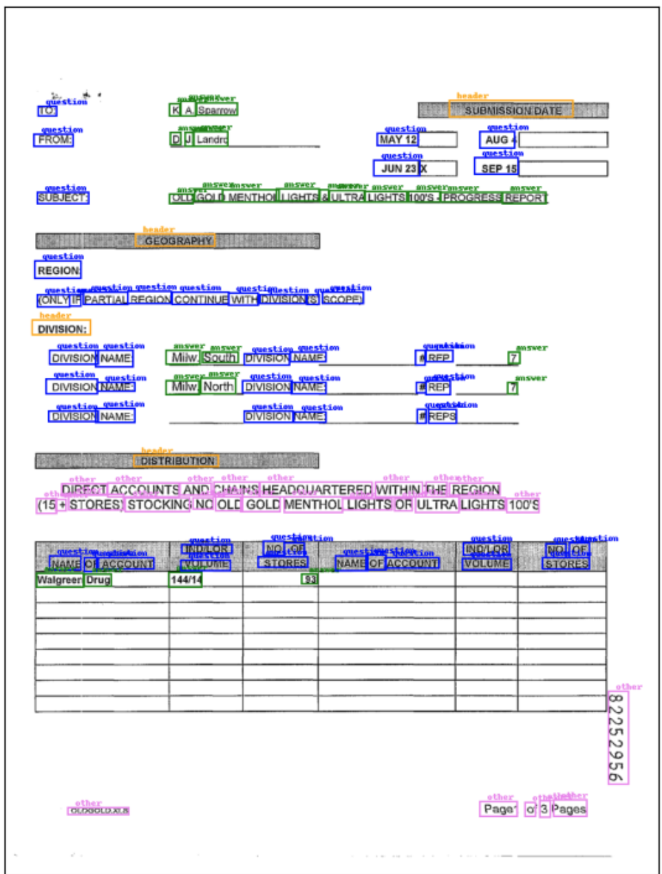
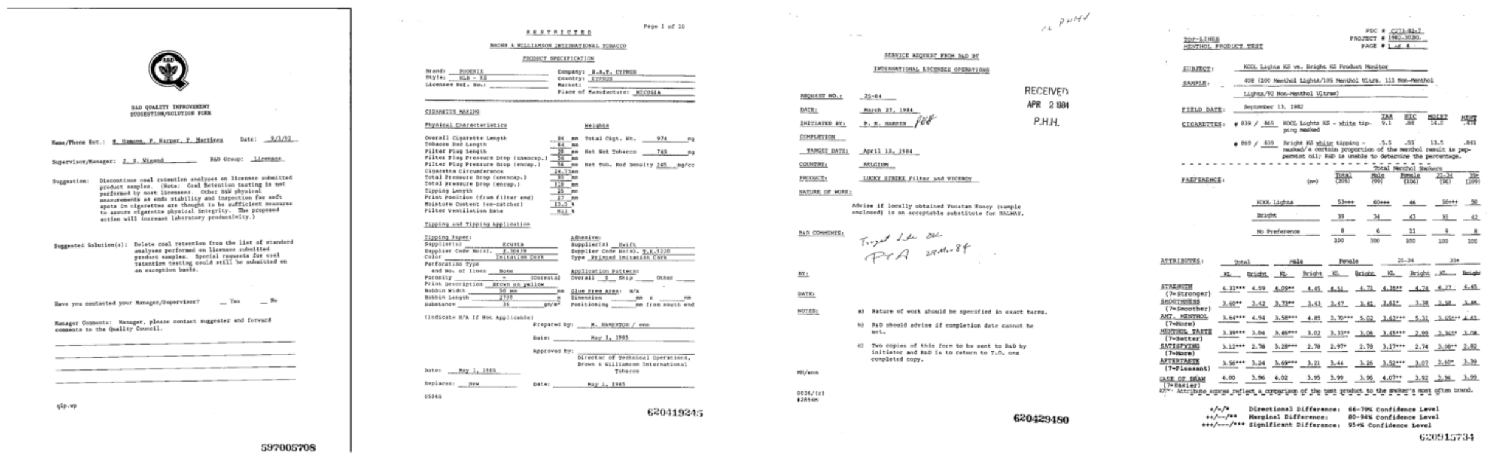
Exploratory Data Analysis – FUNSD Dataset
Subset | No of Forms | No of Words | No of Entities | No of Relations
Training | 149 | 22512 | 7411 | 4236
Testing | 50 | 8973 | 2332 | 1076
Subset | Header | Question | Answer | Other | Total
Training | 441 | 3266 | 2802 | 902 | 7411
Testing | 122 | 1077 | 821 | 312 | 2332
199 Document images with diverse formats
100 dpi resolution
Noisy due to repeated scanning and printing
7411 Entities can be used for training on Entity Labelling Task
4236 Relations can be used for training on Entity Linking Task
Adequate for Fine-tuning a Pre-trained a Large Language Model

Slide 10
Methodology
Data Preprocessing
Evaluate Model
Refine and Retrain
Define Model Architecture
Define Training Strategy
Set Hyperparameters
1. Data Preparation
- Acquire and format the FUNSD dataset for LayoutLMv2 compatibility.
- Pre-process for token-level annotations from world level annotations.
2. Model Architecture
- Utilize pre-trained LayoutLMv2 for understanding document layout and text.
- Fine-tune using Hugging Face transformers library on google Colab
3. Training Strategy
- Employ cross-entropy loss for optimization (penalize wrong prediction more)
- Partition FUNSD dataset for training and testing.
- Use AdamW optimizer for better model parameter updates and fine-tuning.
4. Hyperparameter
- Set learning rate, batch size, and epochs.
5. Evaluation
- Test against benchmarks using Accuracy, Precision, Recall, and F1-score using FUNSD Test set.
- Focus on achieving high scores to ensure comprehensive document understanding.
7. Feedback and Iteration
- Refine and retrain based on feedback for optimal model performance.

Slide 11
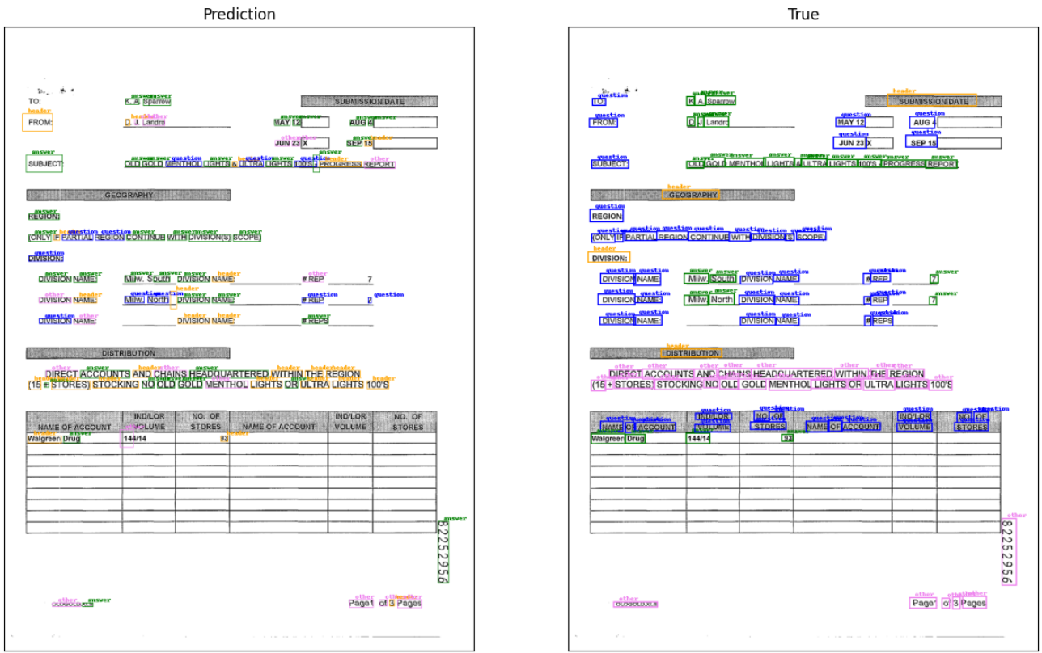
Results and Discussion – Inference from Pre-trained Model
For pre-trained model label(ids) hold no meaning
Fails to recognize contextual entity relationships.
Labels non-text elements erroneously (e.g. “=“).
Does not differentiate between similar entity categories.
Struggles with multi-word entities, inconsistently labels parts.
Mislabels data due to lack of domain-specific training.

Slide 12
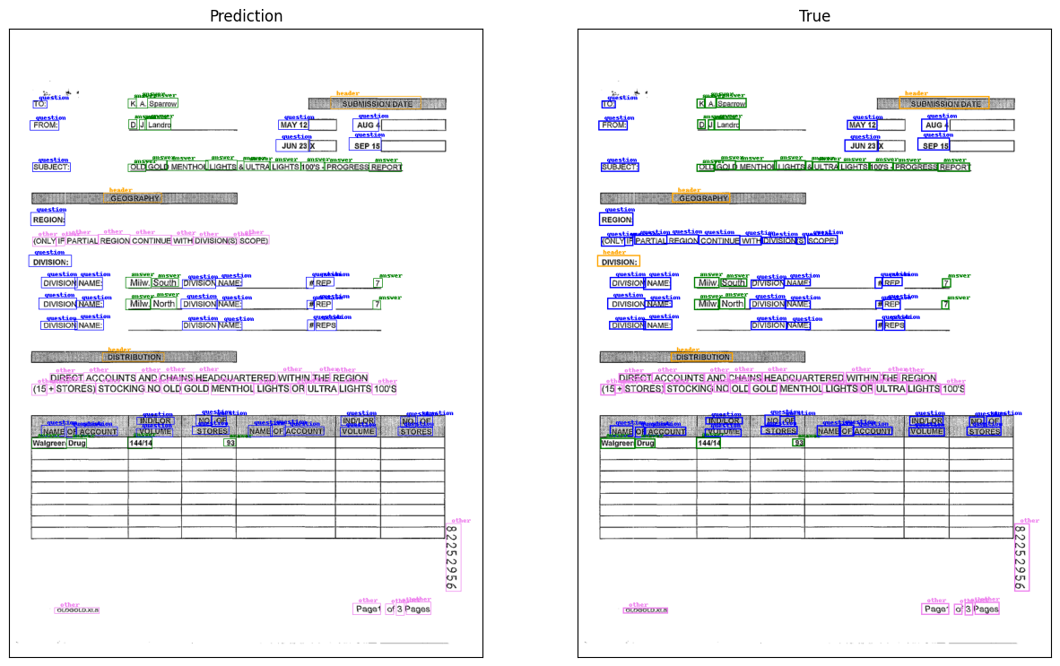
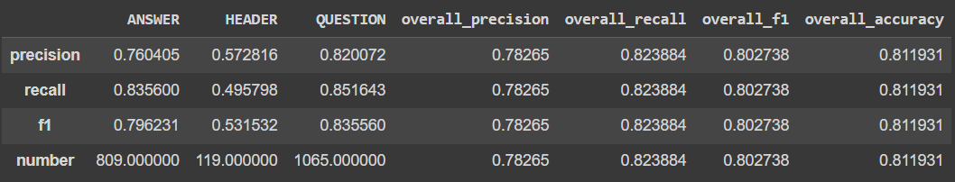
Results and Discussion – Inference from Fine-tuned Model
What the Model got Right:
- It correctly identified and classified several headers, questions, and answers with precise bounding boxes.
- The model was able to distinguish between different entity types for many entities.
What the Model got Wrong:
- There are instances where the model has misclassified certain entities, for example, some entities labelled as 'other' might be 'question' or 'answer'.
- There are discrepancies in the number of entities identified, where the model either missed some entities or incorrectly segmented and classified single entities into multiple parts.

Slide 13
Hyperparameter Tuning
Learning Rate
Best performance -> 5.00E-05 -> F1 Score 0.802
Highest Recall -> 0.823 -> strong ability to identify all relevant instances.
Worst performance -> 6.00E-05 -> F1 Score 0.76
Higher learning rates (up to a point) may help the model better optimize its weights and biases.
Beyond this optimal point (5.00E-05) model beginning to overshoot the optimal weights, thus reducing its ability to generalize the data accurately.
Learning Rate | Precision | Recall | F1 | Accuracy
1.00E-05 | 0.771 | 0.811 | 0.79 | 0.809
2.00E-05 | 0.799 | 0.797 | 0.798 | 0.8
3.00E-05 | 0.761 | 0.789 | 0.775 | 0.814
4.00E-05 | 0.742 | 0.799 | 0.769 | 0.81
5.00E-05 | 0.783 | 0.823 | 0.802 | 0.812
6.00E-05 | 0.744 | 0.777 | 0.76 | 0.765
Number of Epochs
Epoch 1 -> All metrics < 0.5 -> model is just beginning to learn from the data.
Epoch 5 -> All metrics > 0.75 -> model has learned a substantial amount from the training data.
Epoch 10 -> Peak performance -> F1 score 0.802 Accuracy 0.812. Model balance between overfitting and underfitting is optimal.
Epoch > 10 -> noticeable drop in all metrics Precision 0.747 F1 0.776.
Epochs | Precision | Recall | F1 | Accuracy
1 | 0.466 | 0.36 | 0.406 | 0.451
5 | 0.775 | 0.792 | 0.783 | 0.799
10 | 0.783 | 0.823 | 0.802 | 0.812
15 | 0.761 | 0.798 | 0.779 | 0.802
20 | 0.771 | 0.816 | 0.792 | 0.786
25 | 0.747 | 0.808 | 0.776 | 0.789

Slide 14
Hyperparameter Tuning
Batch Size
Size 2 -> lowest recall and F1 score
Size 4 -> highest F1 score and accuracy of all batch sizes tested, improves recall significantly without compromising much on precision
Size 6 -> decrease in all metrics, suggesting it might not be as efficient as smaller batches for this dataset and model configuration
Size 10 -> slightly better than for batch size 2 but still lower than for batch size 4
Overall, a batch size of 4 seems to provide the best balance between precision, recall, F1 score, and accuracy for this dataset and model.
Interpretation
Generalization: Batch size 4 seems to strike a balance between these extremes. It is large enough to provide stability in the gradients, reducing the noise seen in very small batches like 2, yet small enough to retain some level of noise, which helps in escaping poor local minima and promotes better generalization.
Batch Size | Precision | Recall | F1 | Accuracy
2 | 0.784 | 0.765 | 0.774 | 0.776
4 | 0.783 | 0.824 | 0.803 | 0.812
6 | 0.752 | 0.791 | 0.771 | 0.783
10 | 0.782 | 0.796 | 0.789 | 0.81

Slide 15
Conclusion
We began with a thorough exploratory data analysis that informed our preprocessing and model configuration strategies.
The preprocessing steps were designed to transform image data and annotations into a model-friendly format, laying the groundwork for effective model training.
The we carried out fine tuning - F1 score of 0.802 and an Accuracy of 0.812 – model able to generalize the knowledge it had learned without overfitting to the training data.
Adjustments to the learning rate, batch size, and epochs were made with the goal of optimizing the model's performance, with 5e-5 learning rate, 10 epochs and a batch size of 4 emerging as the most effective configuration. Higher learning rates (up to a point) may help the model better optimize its weights and biases.
Thus post required preprocessing, model selection, and strategic fine-tuning, a pre-trained LLM can be adapted for the task of form understanding.

Slide 16
Future Recommendation
Datasets : Larger refined datasets can be used for fine-tuning. Fine-tuning on invoice dataset could significantly enhance its performance on forms due to shared crucial tasks such as word grouping, entity labelling, and entity linking. Invoices, like forms, consist of structured data where entities like dates, amounts, and names are critical for comprehension.
Layout Embeddings : Different methods of encoding the bounding box coordinates. Relative positional, sinusoidal, etc to be explored. Still an active area of research
Fine-tuning methods/ensemble : LORA, QLORA, leveraging Axolotl library for Adapter fine tuning, etc
Pre-trained Model Selection : Decoder, Encoder-Decoder model performance on form understanding. A comparative study on model sizes will also help understand effect of model size on performance. Hardware requirements to be scaled up proportionally.
Document Image Pre-processing/Augmentation : To develop feature maps that emphasize linked entities and are able to separately encode general text versus labelled entities

Slide 17
Thank you

